Slide 1
Academic Review A dive into the effects of different variables on student performance in US Public Schools
Paper Straws. LLC
Notes:
mw

Slide 2

Motivation
NFL → Radiation → Books → Plastic Waste → Education
Background: The team decided on Education due to the numerous and robust datasets available, and less so due to personal interest in the topic.
Reasoning:
Discoursed topic
Relatable topic
Digestible topic
Enrollment in GT bootcamp
David’s kids
Notes:
mw

Slide 3
Core Questions and Hypotheses
Is student performance* in the US affected by student:teacher ratio?
Is student performance* in the US affected by teacher salary?
Is student performance* in the US affected by school financials?
Is student performance* in the US affected by per student spending?
Null hypotheses (Ho): Student:teacher ratio does not have an effect on student performance
Null hypotheses (Ho): Teacher salary does not have an effect on student performance
Null hypotheses (Ho): School financials do not have an effect on student performance
Null hypotheses (Ho): Per student spending does not have an effect on student performance
*”Student performance” defined as High School graduation rate
Notes:
scott

Slide 4
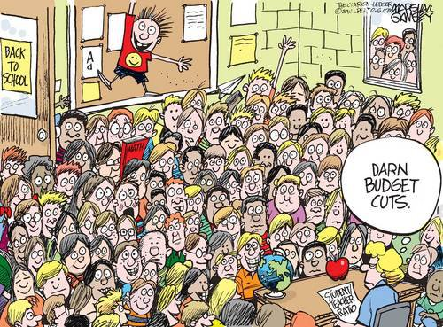
Discovery and Analysis
Notes:
scott

Slide 5

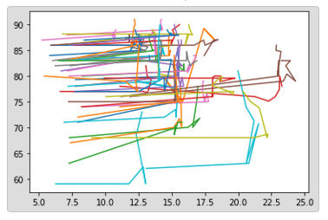



Our Process
Notes:
Sean

Slide 6

Discovery and Data Sources
Google
Kaggle
US Department of Education
US Department of Labor
National Center for Education Statistics (NCES)
National Education Association (NEA)
Census
Our Brains!
Notes:
Sean

Slide 7
Data Cleanup
Deep dive into datafiles
Identify outliers and issues from visualizations
Cleanup directly in excel file as well as Jupyter notebooks
Oklahoma
Alabama
etc
Re-defined parameters
Re-established metrics
Notes:
Saurin

Slide 8
Data Analysis
Review datasets
Discuss strategy
Brainstorm visualizations
Manipulate data real-time
Determine charts and chart types for presentation
Identify data for statistical analysis requirement
Analyze data and visualizations, uncover findings
Notes:
Saurin

Slide 9
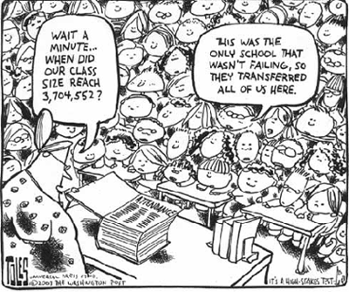
Findings
Notes:
Saurin

Slide 10
Key Findings
Is student performance* in the US affected by student:teacher ratio?
Although student-teacher ratio has been flat over the years, there is an inverse relationship between student:teacher ratio and graduation rate
Is student performance* in the US affected by teacher salary?
An increase in teacher salary across the US is correlated with higher graduation rates
Is student performance* in the US affected by school financials?
An increase in allocated revenues is correlated with higher graduation rates
Is student performance* in the US affected by per student spending?
An increase in per student spending is correlated with higher graduation rates
Notes:
scott

Slide 11
US Public Schools Overview
~57m students attended elementary, middle, and high schools across the US in 2019
Highest enrollment ever reported for public schools
3.7m teachers 2019
Average salary $59k
US gov’t allocates 8% to public schools ($706B)
Best graduation rate:
Missouri 88%
Worst graduation rate:
DC 69%
Notes:
mw

Slide 12
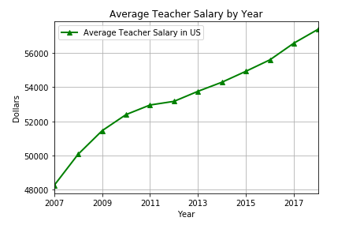
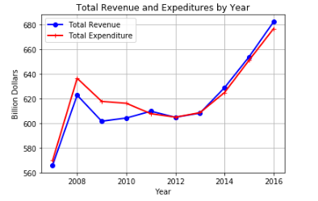
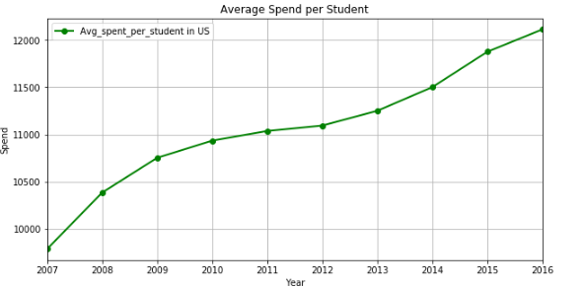
Aggregate Findings – US Trends
As of 2013, teacher salaries increased at a higher rate than recent previous years. Expenditures and avg spend per student also increased during this timeframe
In addition, a change in educational standards was implemented in 2013, which was that there was a shift from focusing only on standardized tests, to include a focus on life and educational skillsets
Increased focus on higher graduation rates overall in US in recent years; such as “No child left behind” initiatives
For the Class of 2015, which had a graduation rate of 82.43 percent, a 90 percent graduation rate would have meant an additional 250,000 students would have walked across the Commencement Day stage.These graduates would collectively have earned $3.1 billion ANNUALLY in additional income.That additional income isn’t going under the mattress. It’s being spent in local grocery stores, restaurants, and other businesses, powering national, state, and local economies. And these new graduates are also contributing more in the form of tax dollars—roughly $664 million collectively by the midpoint of their careers. That tax revenue will go toward public schools, roads, and a variety of other public goods. In total, the collective spending power of these new graduates will lead to greater opportunities for the nation, including $5.7 billion in economic growth and more than 14,000 new jobs created. And because high school graduates tend to live more healthy lives than high school dropouts—and because they are more inclined to obtain and have their own health insurance throughout the course of their lives, these new graduates will save the nation $16.1 billion in health care costs.
2:53
done son
2:55
And then we can co-relate to the economy. Ofcourse they are million other factors for economy to grow but education is one of the big one
melissa 2:57 PM
oh yea that's good info
Saurin Patel 2:57 PM
And i don't think anyone will que
Notes:
Saurin

Slide 13
Aggregate Findings – US Trends
Correlated with increase in various spends in the previous slide is an increase in graduation rates in recent years
Higher graduation rates result in:
Additional personal income
Additional tax dollars generated, which help fuel economic, and therefore Educational growth
General overall economic growth: lower healthcare costs, revenue back into state and local communities, generating new jobs
Notes:
Saurin

Slide 14
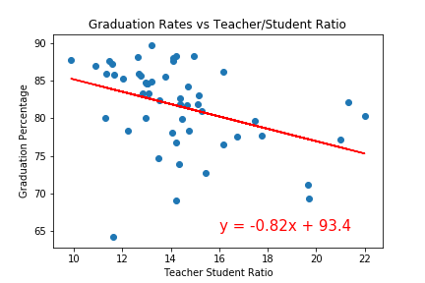
Granular Finding - States Regress
R-value: -3.856
Research has shown that:
Smaller classes, especially in a child’s younger years, leads to better academic performance
Minority and low-income students perform better when placed in smaller class size
The more years a student spends in reduced class sizes, the longer improved performance continues
Classes at 20 or above tend to fail in attempts at reduced class sizing
Notes:
sean

Slide 15
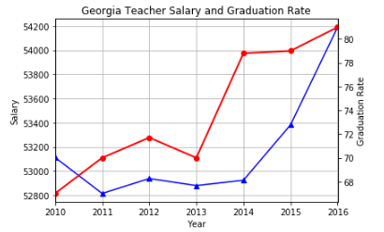
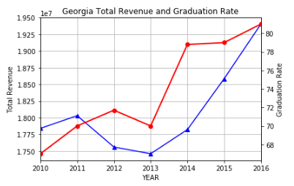
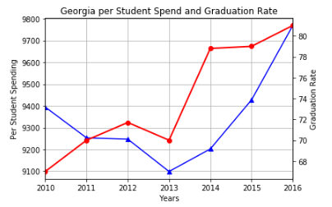
Micro Findings – Georgia
As with overall US trends, we see a shift in graduation rate as of 2013
Graduation rate (red trendline) does not seem to be as highly correlated with the factors studied until 2016; the change in GA may be moreso due to the change in 2013 to remove focus from standardized testing, with monetary factors being a secondary contributor
2016 is more aligned when it comes to revenue and graduation rate in GA; this may also be due to a lag effect
Notes:
mw

Slide 16
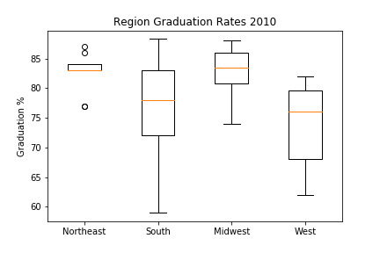
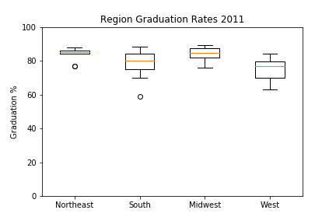
Regional Findings – Statistical Testing
The Northeast has the smallest spread in graduation rate of all the Regions studied
2010-2013, the Northeast is the only region with outliers
Notes:
scott

Slide 17
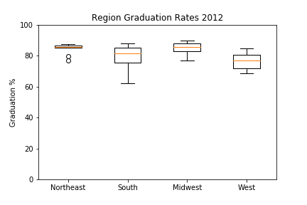

Regional Findings – Statistical Testing
2013-2016, both the Northeast and the South contain outliers
2010 and 2012 Southern Region graduation rates reflect a large spread
Notes:
scott

Slide 18
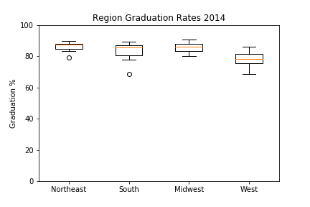
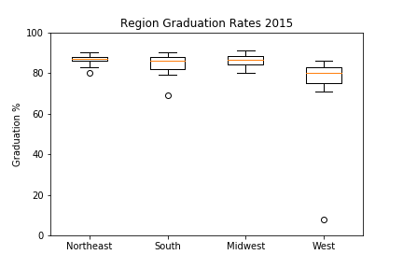
Regional Findings – Statistical Testing
Notes:
scott

Slide 19
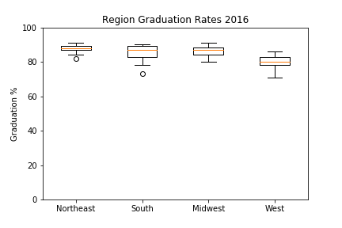
Regional Findings – Statistical Testing
Results show that X region has a y difference – reference mean if applicable, basically stating here what you saw that made you do the anova/t test
Notes:
scott

Slide 20

Implications
Notes:
scott

Slide 21
Implications
Our team found that increases in spends is correlated to higher graduation rates. Implies that if the US spent more on Education, graduation rates would only improve further.
For discussion: Do you agree or disagree? Why?
For discussion: Was the US increase in recent years in teacher salary and other spends surprising to you? Why or why not?
Our team found that the US graduation rate between 2014-2015 declined slightly (0.5%), but GA rate remained flat (or increased just slightly). What do you make of these results?
(discussion point here about scott’s stats findings)
For discussion: Although not specifically revealed in the presentation, many of the top five states in terms of spending have among the worst graduation rates. Why could that be?
Notes:
Sean/saurin

Slide 22
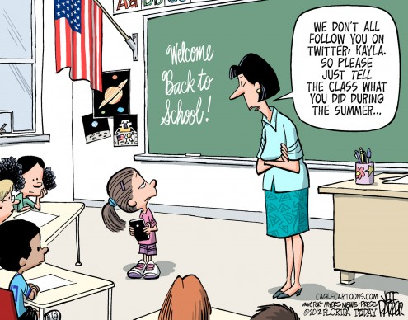
Appendix
Notes:
mw

Slide 23
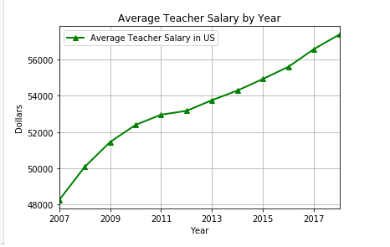
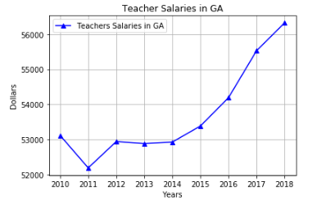
US v GA Average Teacher Salary

Slide 24
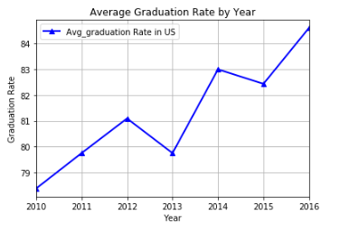
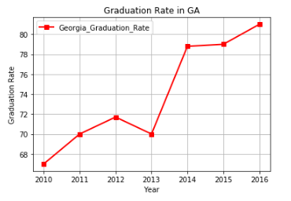
US v GA Graduation Rates

Slide 25
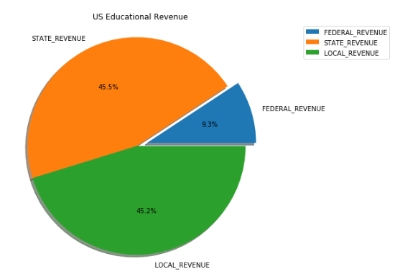
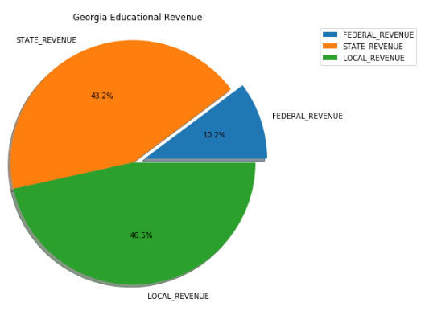
US v GA Educational Revenue

Slide 26
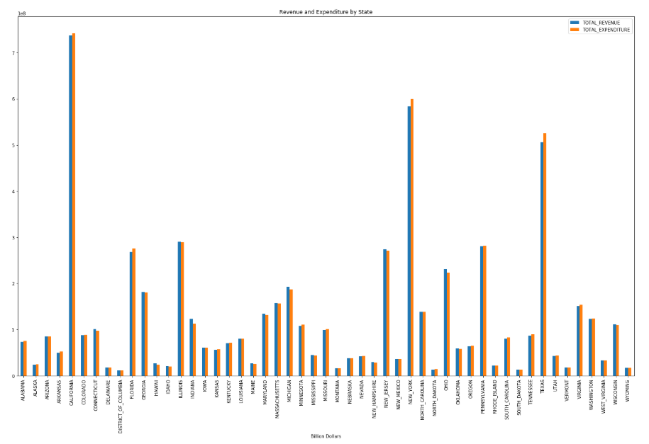

Slide 27
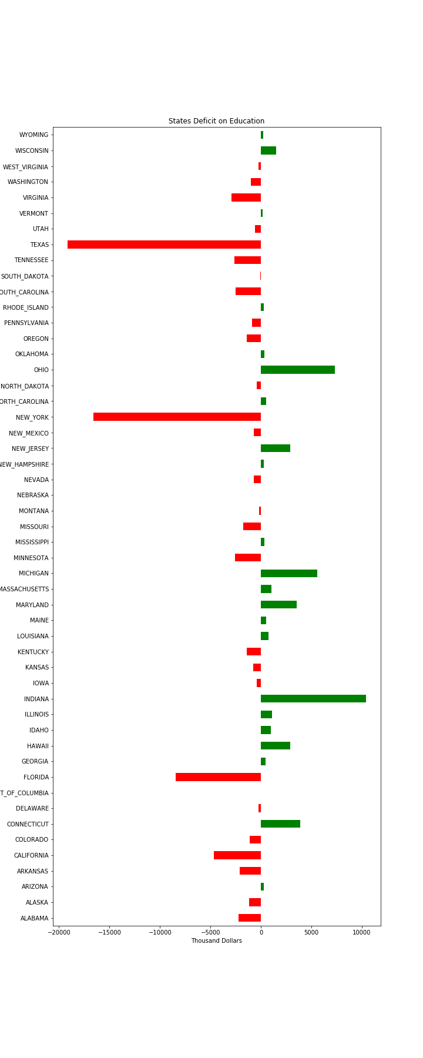
Texas, NY and FL all have the greatest deficits in spend v allocation (these states spend more than they are granted)

